Slide 1


Miao Shi
05/13/2022

Slide 2
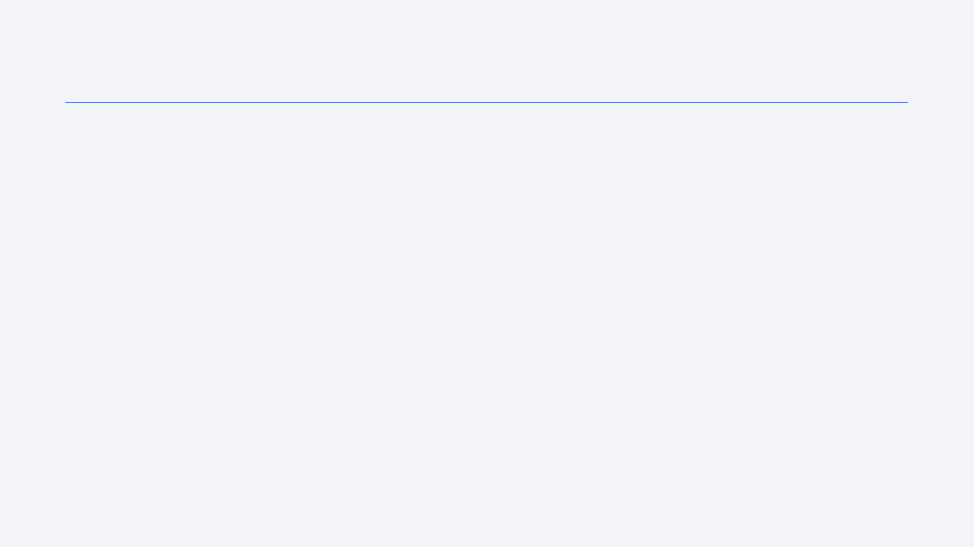
Outline
Executive Summary
Introduction
Methodology
Results
Conclusion
Appendix

Slide 3
Executive Summary
Summary of methodologies
Summary of all results

Slide 4
Introduction
Utilize available data from Space X, learn and build basis for creating a competitor company ”Space Y”, primarily to answer the following questions:
Where to build a launch site?
What payload, orbit, booster versions will have a higher success rate?
What options should we should for landing?
What predictive model should be used?

Slide 5

Section 1

Slide 6
Methodology
Executive Summary
Data collection methodology:
Describe how data was collected
Perform data wrangling
Describe how data was processed
Perform exploratory data analysis (EDA) using visualization and SQL
Perform interactive visual analytics using Folium and Plotly Dash
Perform predictive analysis using classification models
How to build, tune, evaluate classification models

Slide 7
Data Collection
Data is collected from API and Web Scraping

Slide 8
Data Collection – SpaceX API
Get Data
Define URL
Create DataFrame
Parse text content
Deal with missing values
View On GitHub

Slide 9
Data Collection - Scraping
Get Web Page Content
Define Web Page URL
Use BeautifulSoup to parse HTML contentDeal with missing values
Get Table Content
Get table headers as column names
Create dictionary using column names
Loop throw rows, cleanup the data and create DataFrame
View On GitHub

Slide 10
Data Wrangling
Performed exploratory data analysis, by summarizing launch outcomes by Site, Orbit
Get Data
Calculate launches by orbit
Create "Class" column based on Outcome
View missing values and data types
Calculate launches by site
Calculate outcome by orbit
View On GitHub

Slide 11
EDA with Data Visualization
Used scatter plot to explore the relationship between Flight Number, Payload Mass, Launch Site, Orbit
Used bar chart to explore the relationship between Orbit and Class
Used line chart to explore the relationship between Date and Class
Get Data
Define Chart Data
Show the chart
Choose Chart Type
Define Chart Labels
View On GitHub

Slide 12
EDA with SQL
Get unique launch sites
Display 5 records where launch site starts with ‘CCA’
Display the total payload mass carried by boosters launched by NASA (CRS)
Display average payload mass carried by booster version F9 v1.1
ist the date when the first successful landing outcome in ground pad was acheived.
List the names of the boosters which have success in drone ship and have payload mass greater than 4000 but less than 6000
List the total number of successful and failure mission outcomes
List the names of the booster_versions which have carried the maximum payload mass
List the failed landing_outcomes in drone ship, their booster versions, and launch site names for in year 2015
Rank the count of landing outcomes (such as Failure (drone ship) or Success (ground pad)) between the date 2010-06-04 and 2017-03-20, in descending order
View On GitHub

Slide 13
Build an Interactive Map with Folium
Added Circle and ClusterMarker for launch sites
Added colored successful and unsuccessful markers to compare success rate for each site
Added Polylines to identify the distance between launch site and nearest coastline, highway, rail and city
View On GitHub

Slide 14
Build a Dashboard with Plotly Dash
Added Site dropdown to allow use easily filter result by site
Added pie chart to show % of successful launches by site
Added RangeSlider to filter result by payload
Added scatter plot to show the success rate by Site, Payload, Booster Version
View On GitHub

Slide 15
Predictive Analysis (Classification)
Preprocessing with StandardScaler
Split data into Train & Test set
Use GridSearchCV to find best parameters
Pick a model
Evaluate model with score method and confusion matrix
pick the best model
View On GitHub

Slide 16
Results
Exploratory data analysis results
Interactive analytics demo in screenshots
Predictive analysis results

Slide 17

Section 2

Slide 18
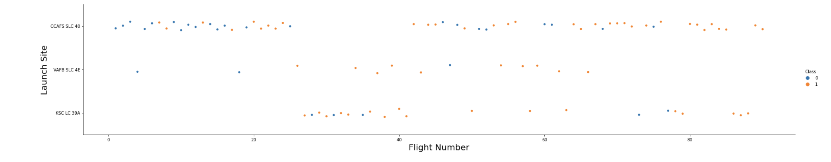
Flight Number vs. Launch Site
Initial FlightNumber started at CCAFS SLC 40, then the flights shifted to KSC LC39A, then shifted back to CCAFS SLC 40
Scattered flights from VAFB SLC 4E, and no activities for more recent flights

Slide 19
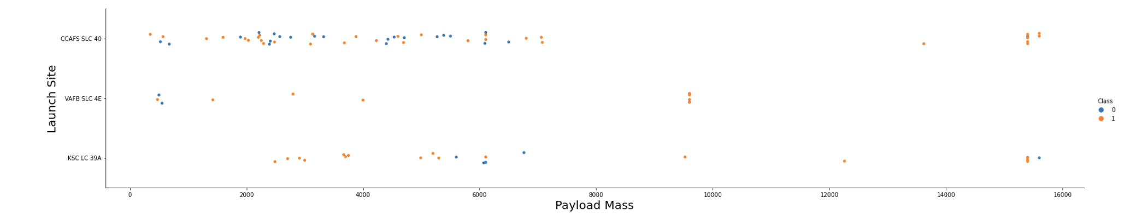
Payload vs. Launch Site
CCAFS SLC 40 is used for lower and extra high payload mass
VAFB SLC 4E is used for lower and mid-range payload mass
KSC LC 39A has not been used for very low payload mass launches

Slide 20
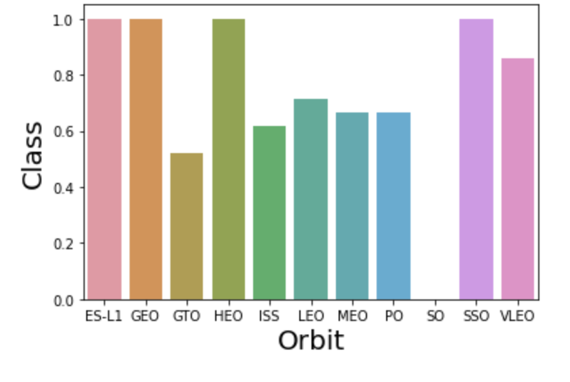
Success Rate vs. Orbit Type
EL-L1, GEO, HEO, SSO, VLEO are the orbits that have higher success rate
GTO, ISS, LEO, MEO, PO and SO have lower success rate

Slide 21
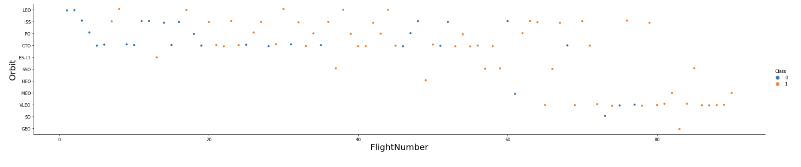
Flight Number vs. Orbit Type
Recent flights re being shifted from LEO, ISS, PO, GRO, ES-L1, SSO to HEO, MEO, VLEO, SO and GEO

Slide 22
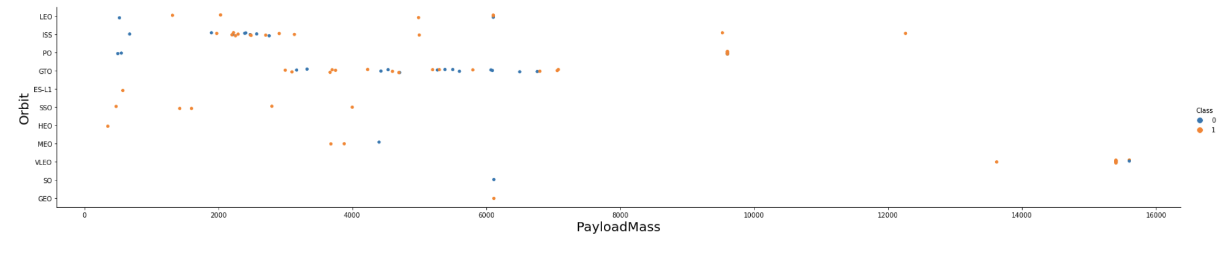
Payload vs. Orbit Type
Lower payload mass launches use ISS orbit more frequently
Mid-lower payload mass launches use GTO orbit more frequently
High payload launches use VLEO orbit

Slide 23
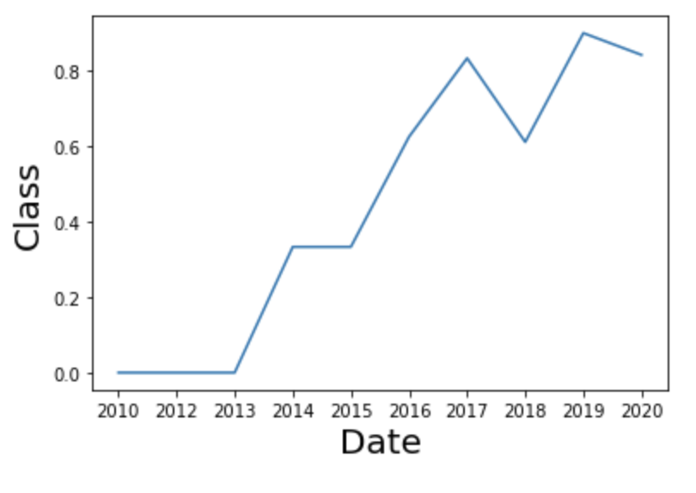
Launch Success Yearly Trend
Success rate has been increasing since 2013, with the exception of 2018 and 2020

Slide 24
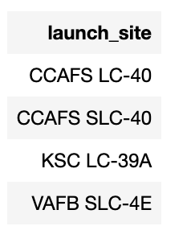
All Launch Site Names
Total of 4 unique launch sites

Slide 25
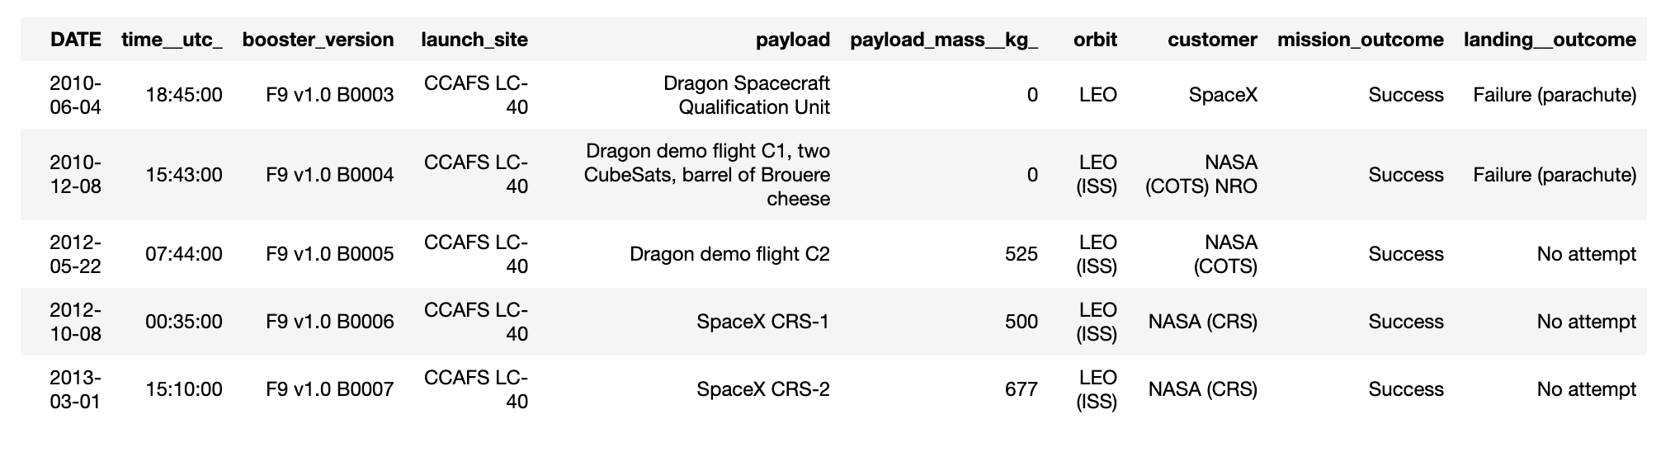
Launch Site Names Begin with 'CCA'
Match launch_site using “like” statement and limit the result to top 5

Slide 26
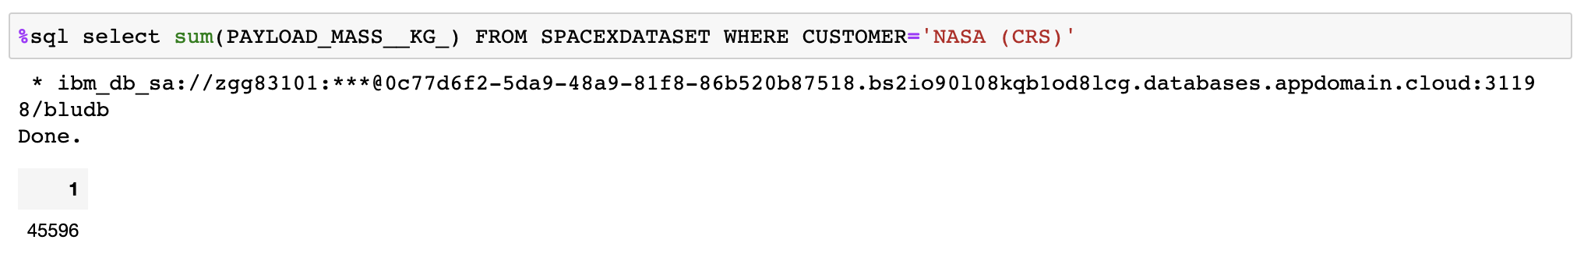
Total Payload Mass
Total Payload Mass launched from NASA (CRS) is 45596 KG

Slide 27
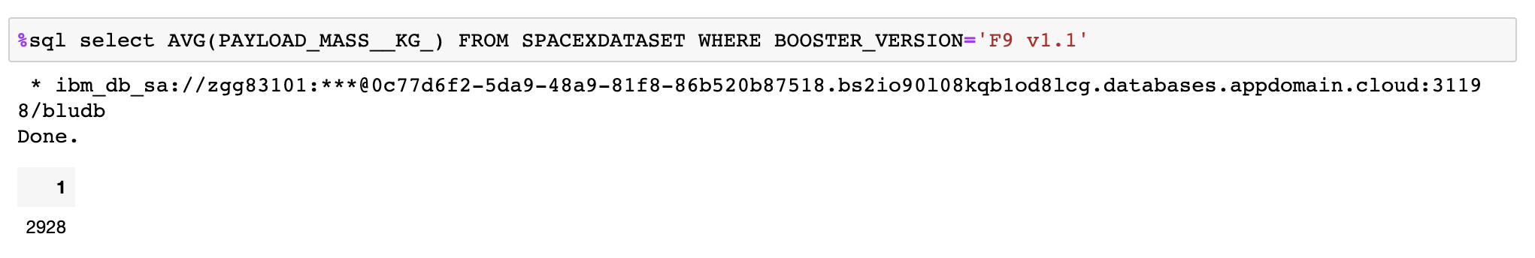
Average Payload Mass by F9 v1.1
The average Payload Mass launched with Booster Version F9 v1.1 is 2928 KG

Slide 28
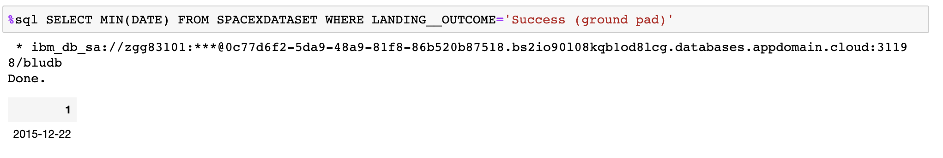
First Successful Ground Landing Date
12/22/2015 is the date for the first successful launch on ground pad

Slide 29
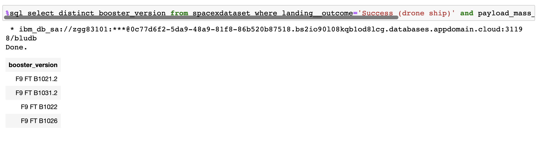
Successful Drone Ship Landing with Payload between 4000 and 6000
The Booster Versions that have successful drone ship landing with Payload between 4000 and 6000 are: F9 FT B1021.2, F9 FT B1031.2, F9 FT B1022 and F9 FT B1026

Slide 30
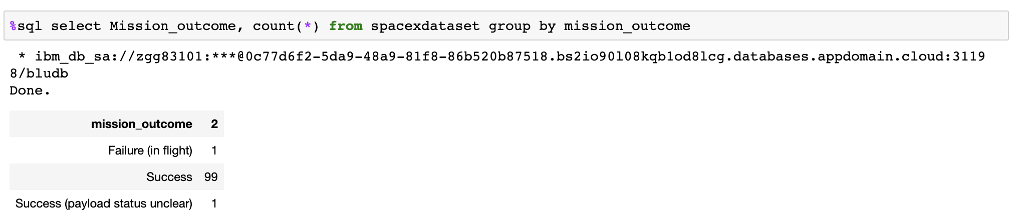
Total Number of Successful and Failure Mission Outcomes
There are total of 1 failed missiong outcome and 100 successful missiong outcomes, including 1 payload status unclear.

Slide 31
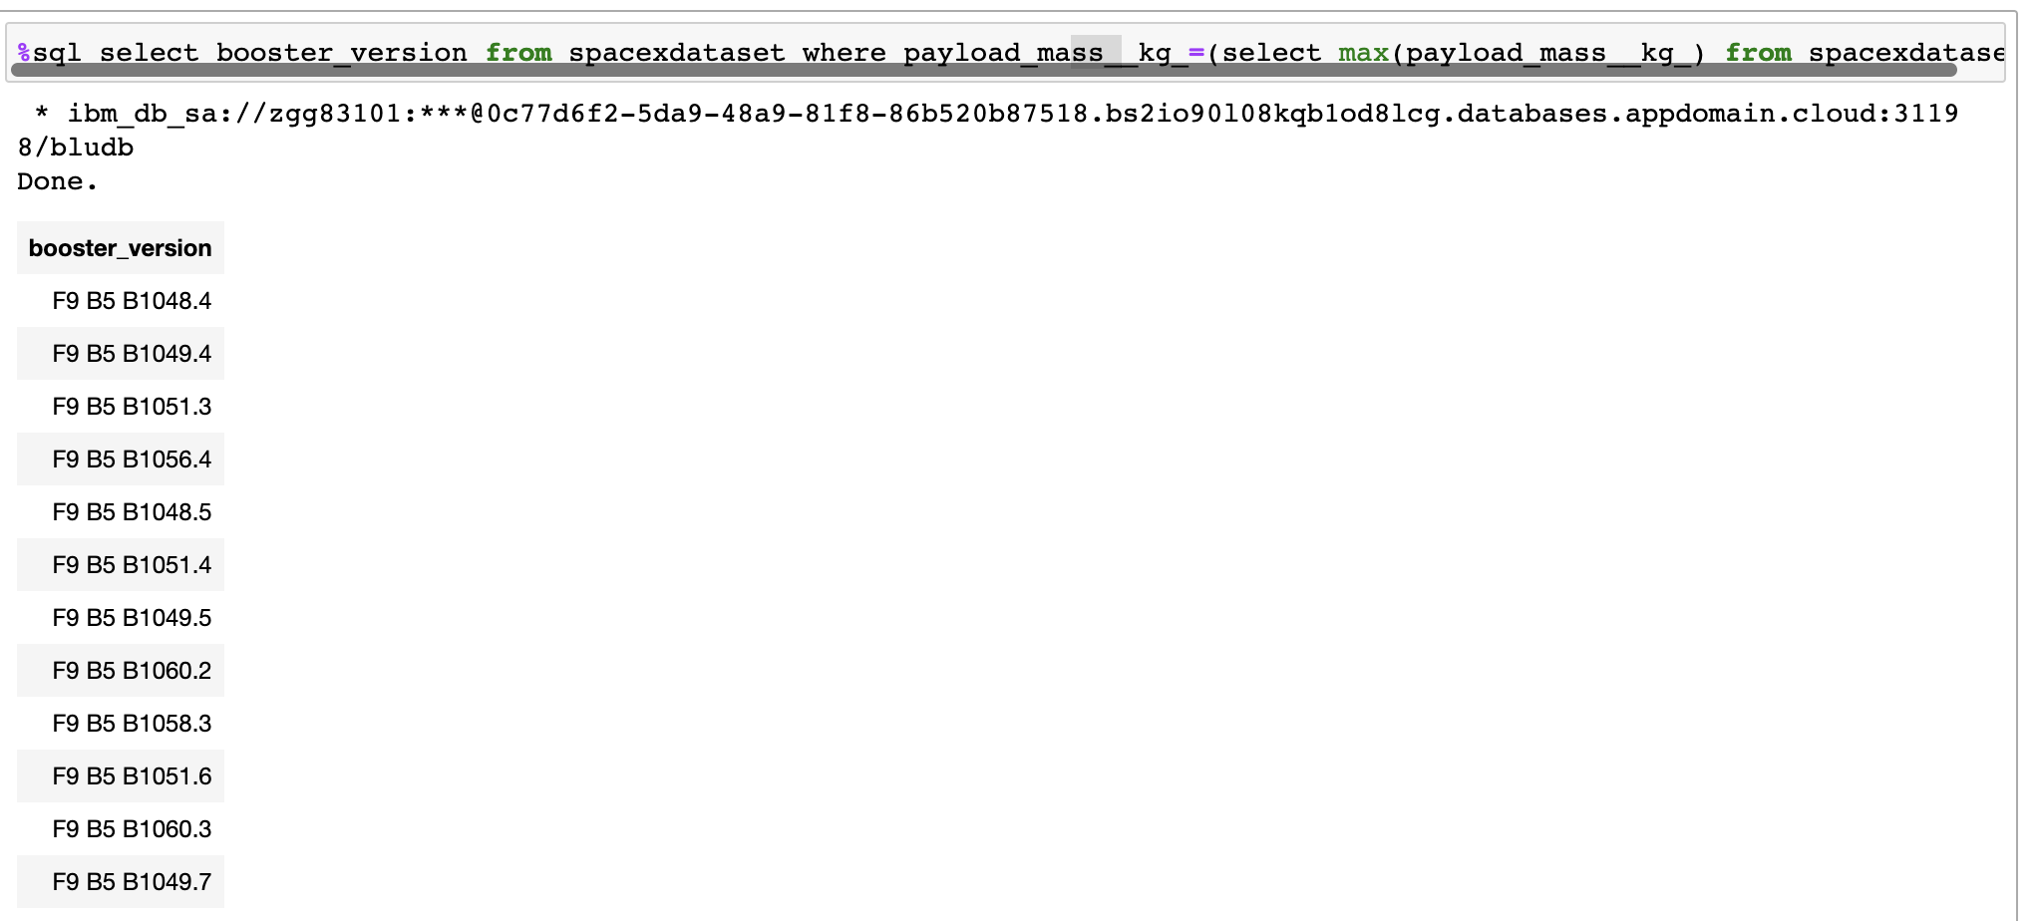
Boosters Carried Maximum Payload
12 Booster versions carried the maximum payload

Slide 32
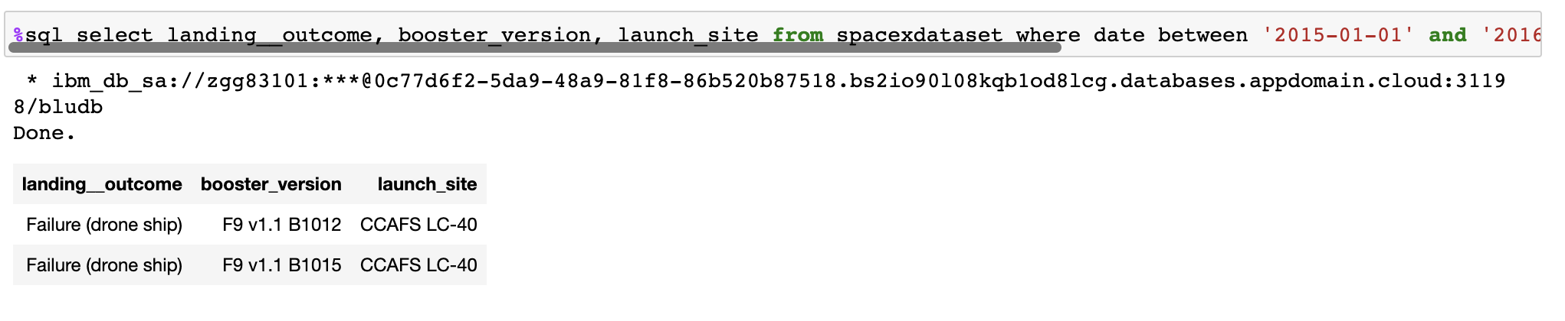
2015 Launch Records
Total of 2 failed landing outcomes, both at CCAFS LC-40, with 2 different booster versions

Slide 33
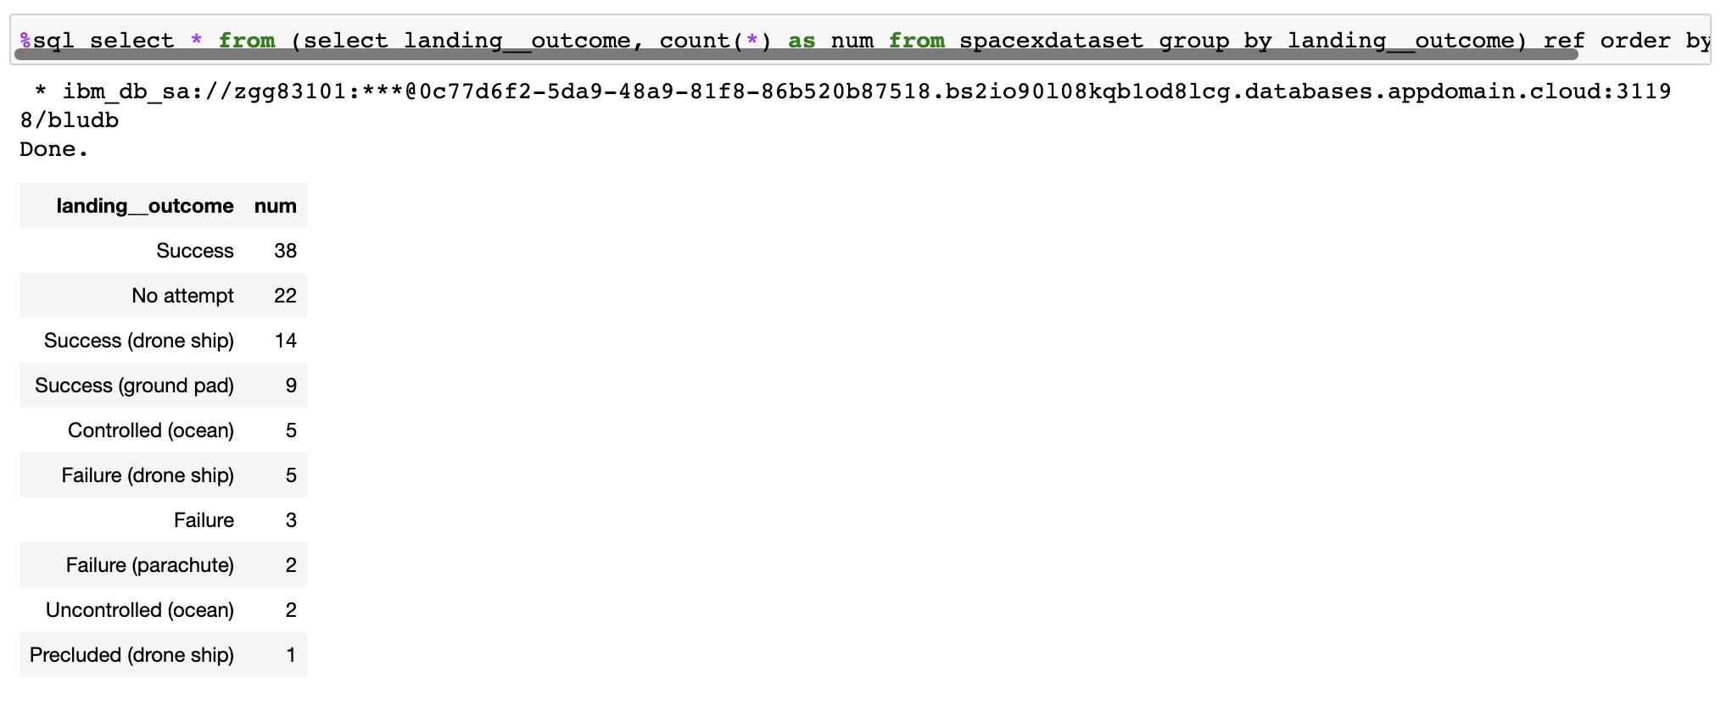
Rank Landing Outcomes Between 2010-06-04 and 2017-03-20
The overall #1 landing outcome is “Successs”
Drone ship is the #1 failed outcome

Slide 34

Section 3

Slide 35
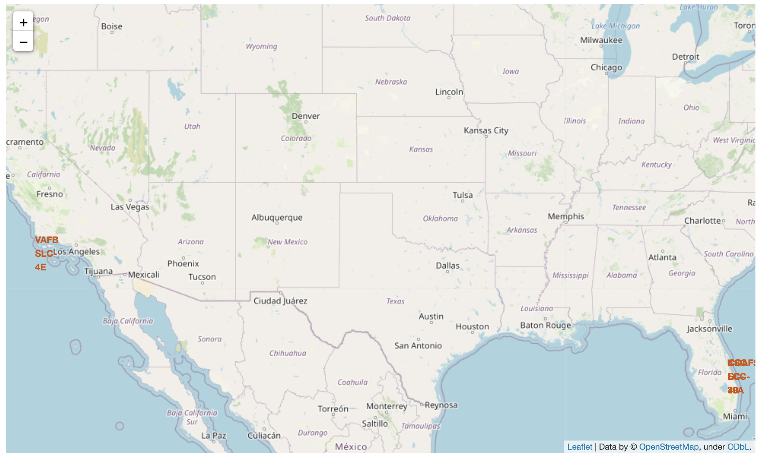
Launch Site Locations
Launch sites are primarily along the coastline

Slide 36
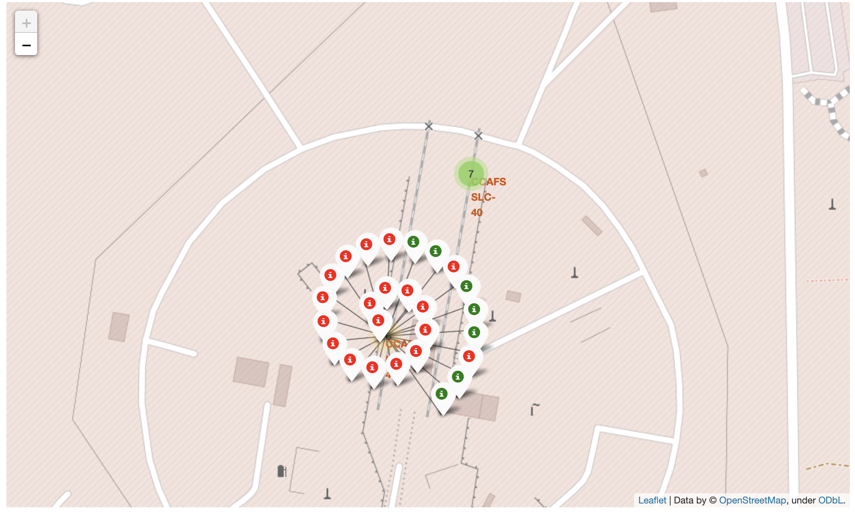
Success Rate at CCAFS LC-40
More failed launches at CCAFS than successful launches

Slide 37
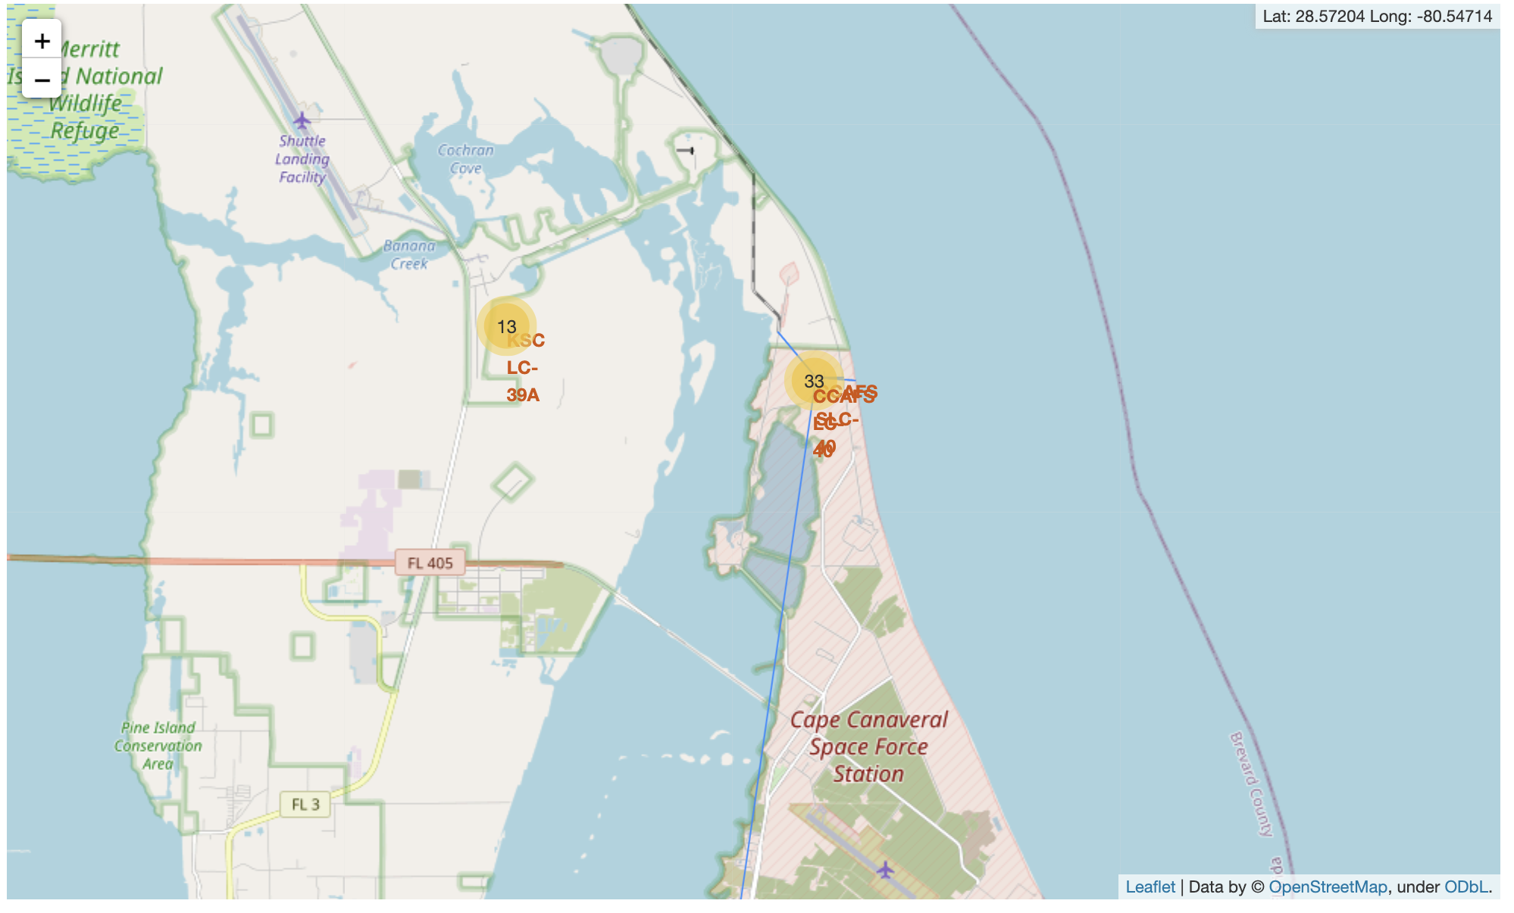
Launch Site Proximities to Landmarks
Launches sites are chosen with close proximities to coastline, highway and railroad, but far from cities

Slide 38

Section 4

Slide 39
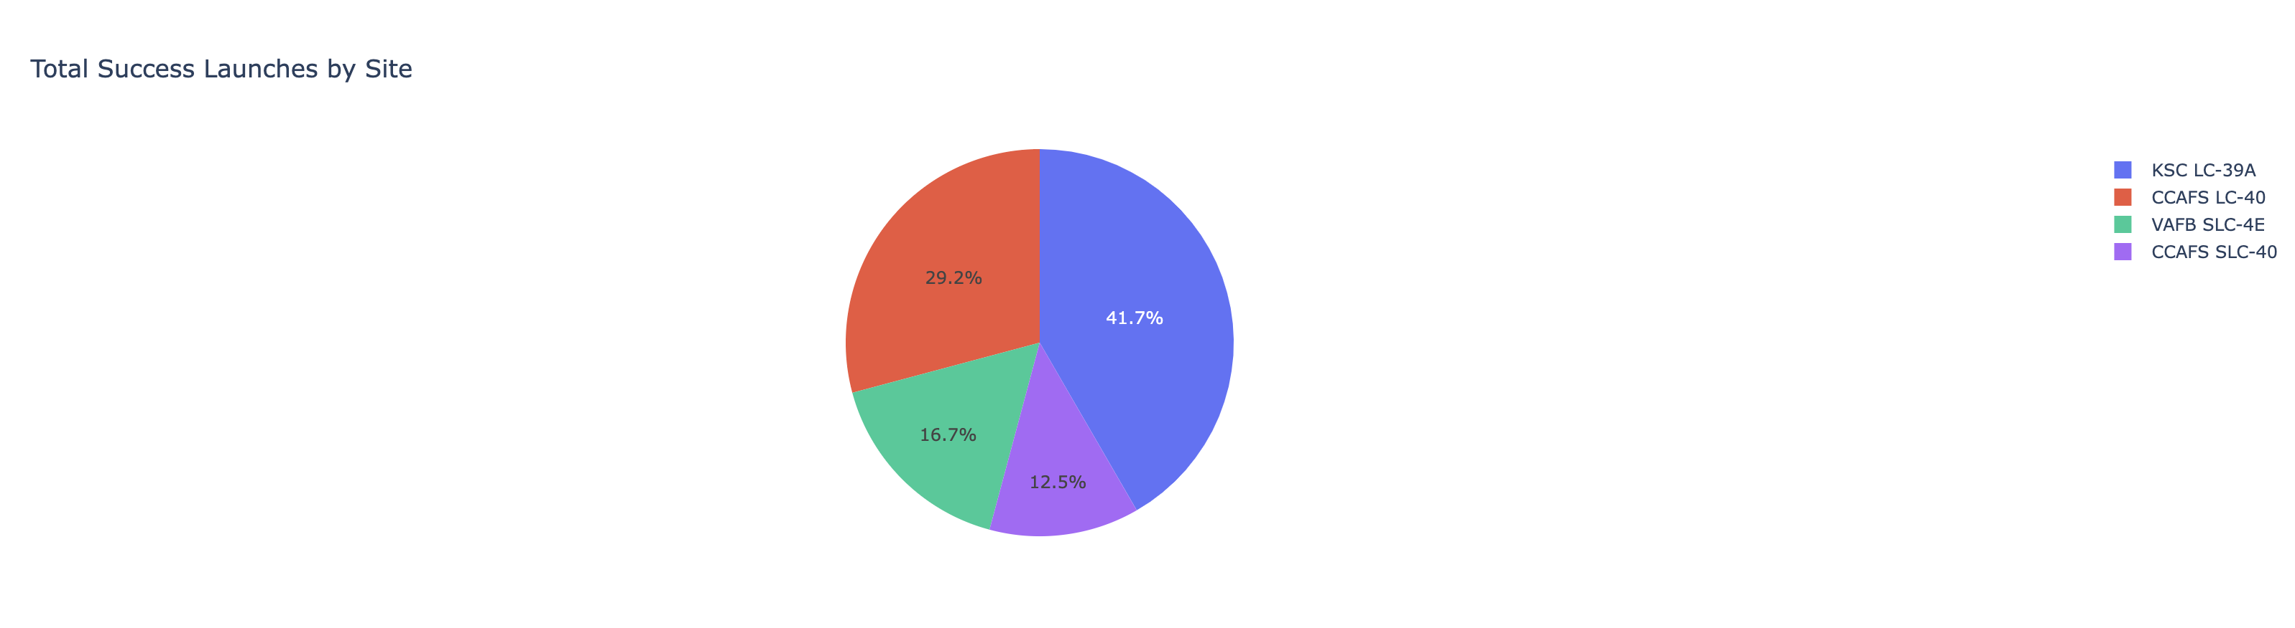
Success Rate by Launch Site
KSC LC-39A has the highest success rate

Slide 40
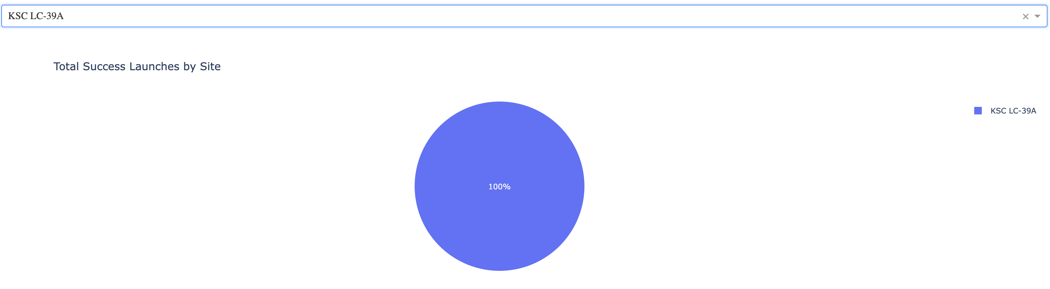
Launch Site with Highest Success Rate
KSC LC-39A has the highest success rate

Slide 41
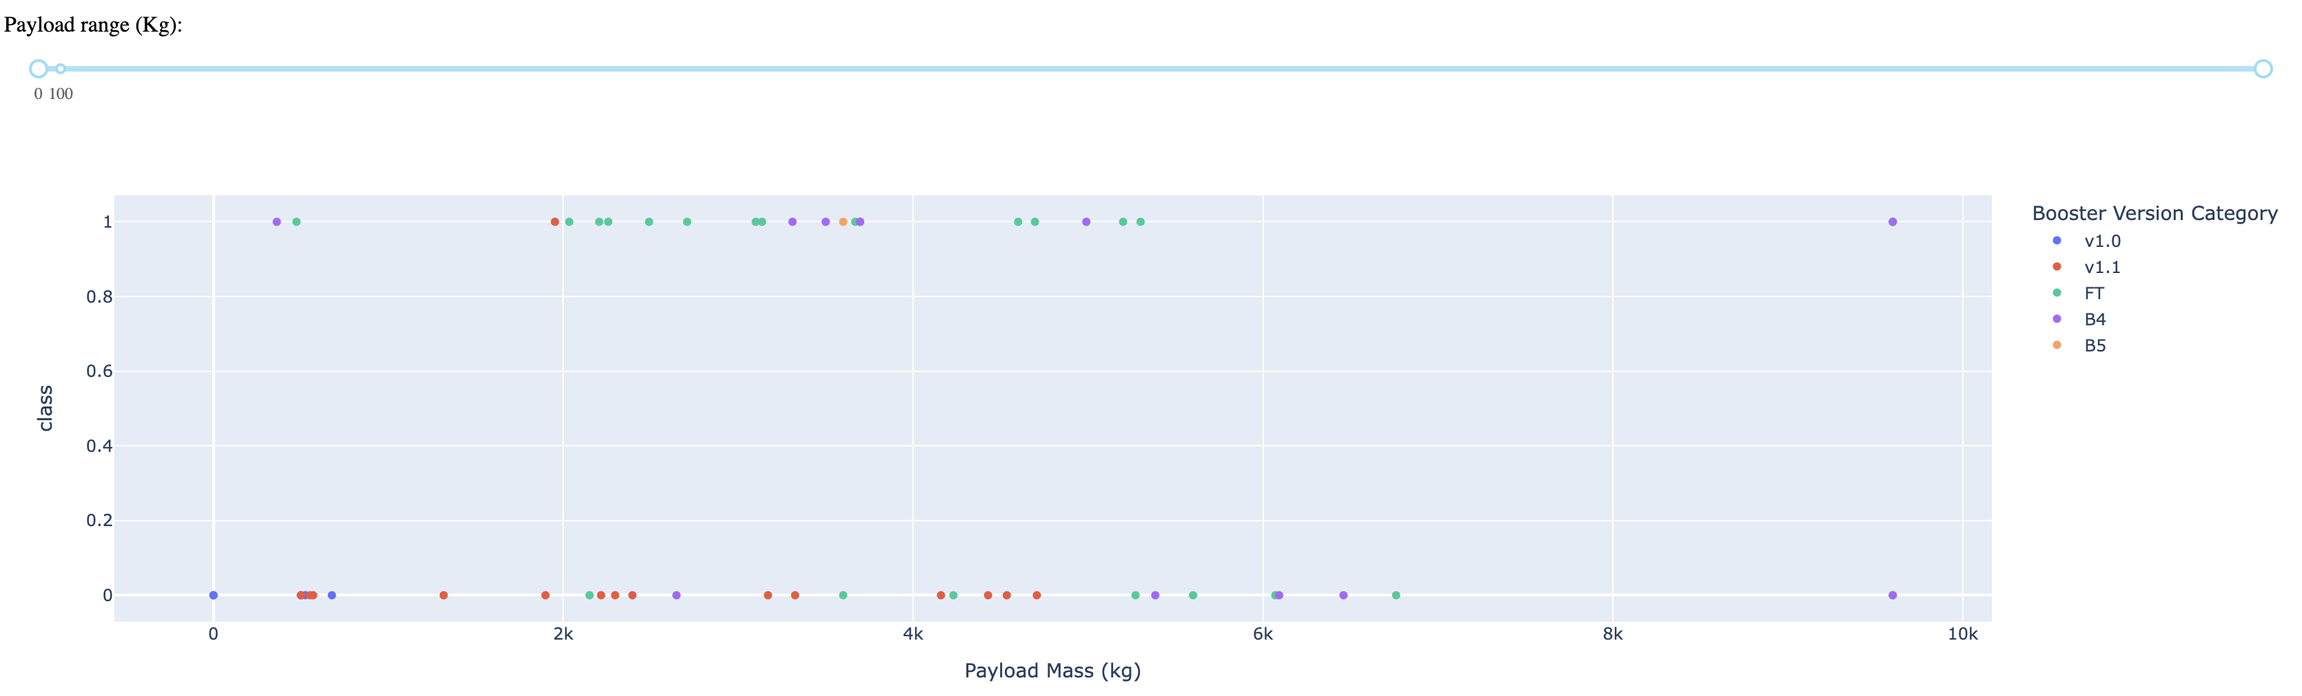
Success Rate by Payload & Booster Version
Payload range between 4000 – 6000 with Booster Version FT has the highest success rate

Slide 42

Section 5

Slide 43
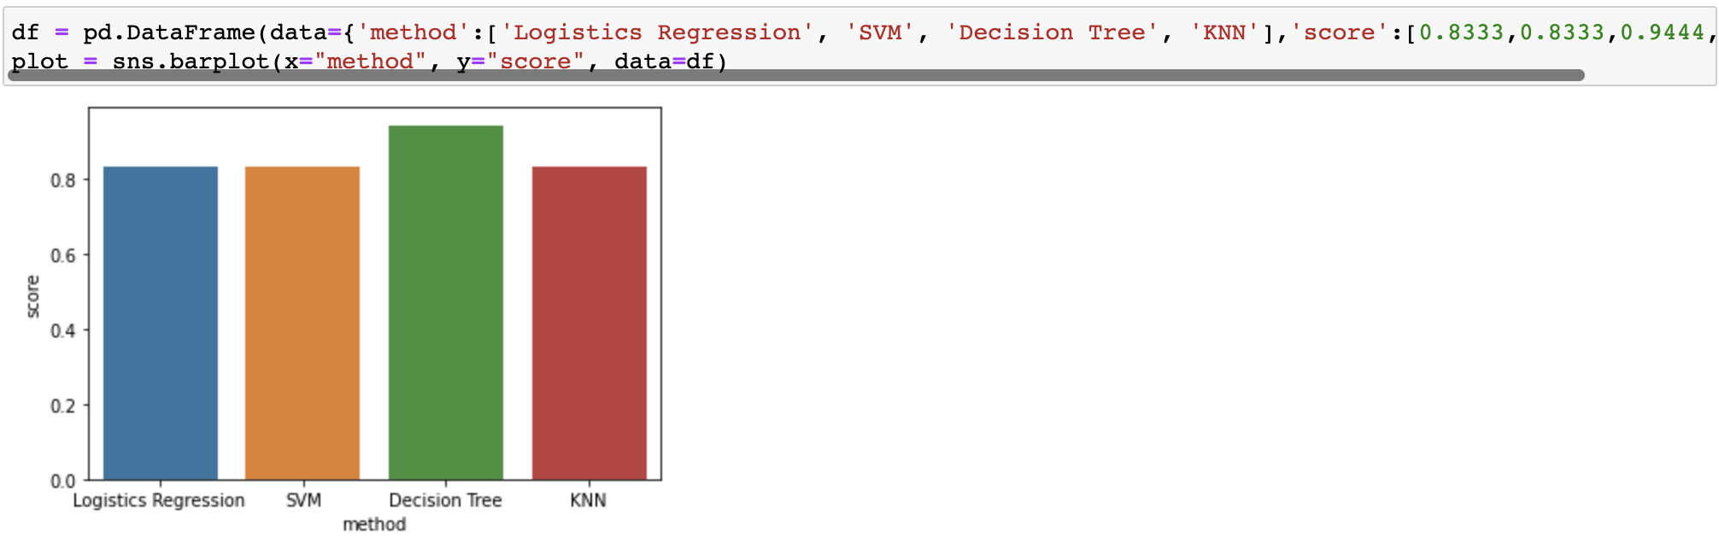
Classification Accuracy
Decision Tree has the highest accuracy out of all the models

Slide 44
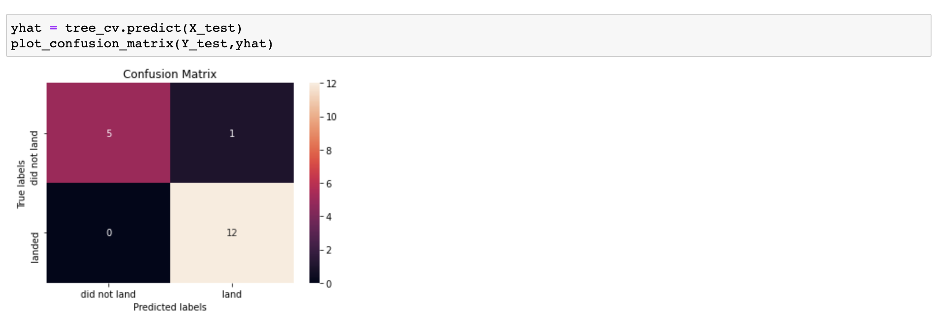
Confusion Matrix
Only 1 false positive result from the prediction

Slide 45
Conclusions
There will be a learning curve in the beginning, launch success rate will improve overtime
EL-L1, GEO, HEO, SSO, VLEO are the orbits for higher success rate
Payload should be between 4000 – 6000 for higher success rate
When choosing a launch site location, we should choose some where has proximity with coastline, highway and railroad, but away from city
Drone Ship landing option is riskier
Decision Tree model will work best for predicting whether if we can have a successful landing result

Slide 46

Appendix
Average success rate from Space X data set is about 66.67%
Logistics Regression, SVM & KNN models generate same confusion matrix in this example

Slide 47


